Slide 1
Team 3 K-developer

Slide 2
3 key features
Gps based garden choosing
To-do list
Photo sharing bulletin (Photos)

Slide 3
Gps based garden choosing
When starting the app, users are provided with their location through gps.
Based on the location provided, the app presents nearby gardens.
Each garden forms its own community.

Slide 4
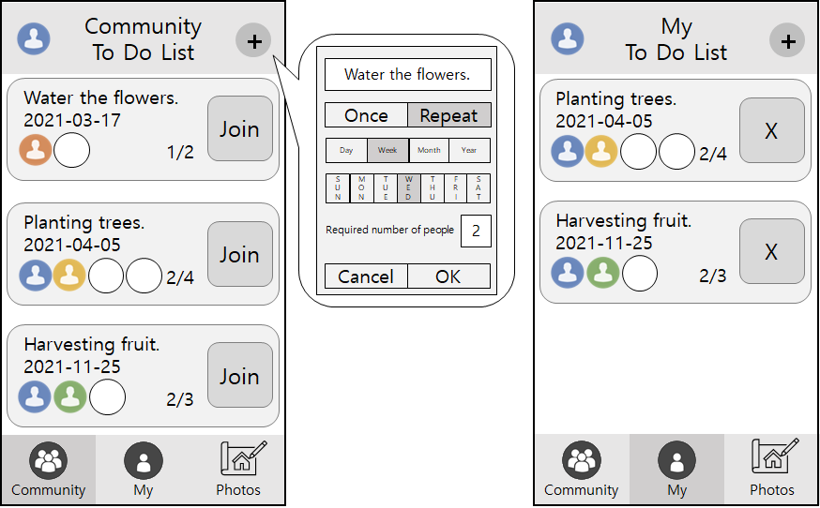
To-do list
When registering to-dos, be sure to specify the number of people you need.
Allow others to participate in what you want to do on your to-do list.
Show me a list of to-dos that I have participated in.
When registering to-dos, make sure they can be repeated according to conditions.

Slide 5
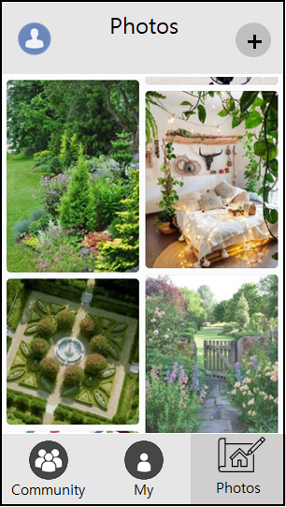
Photo sharing bulletin (Photos)
Users can post messages with photos on the bulletin boards.
Posts are displayed on the screen.
Users can comment on the post.

